Slide 1

Reports.
Who gets them?
What reports?
When are they due?
Where do they go?
Why do we do them?
Seventh District Member Training

Slide 2
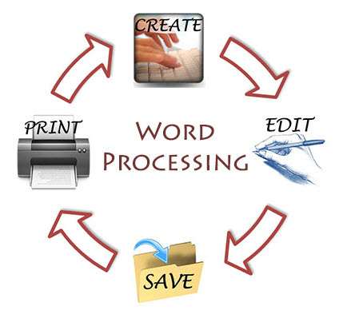
Tips.
Save your monthly report in a word processing program. This will be your template for future reports.
Each month update the month and fill in this month's key points.
Save a copy as a PDF file as this is easier for emailing and storing.

Slide 3

What is common in all reports.
Let’s look at what is common in all reports.
All reports must be submitted both monthly and quarterly.
Each report goes up the next level in the Chain of Leadership and Management (COLM), for broader visibility and continuity.
Content includes:
Key accomplishments.
Significant activities.
Challenges or needs.
Upcoming plans or goals.
Any items requiring assistance or attention.

Slide 4
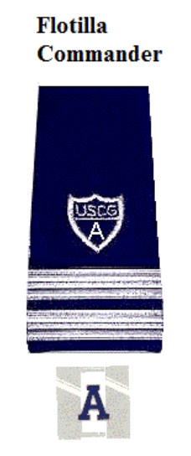
Let’s get started with elected officers. Flotilla Commander (FC).
Flotilla Commander responsibilities:
Submit monthly and quarterly reports.
Due by the 10th of each month to your Division Commander.
Email is the preferred method of submission.
These reports help Division Commanders support flotilla programs and are forwarded through the COLM to assist policy makers.

Slide 5

Division Commander (DCDR).
Submit monthly and quarterly reports.
Reports are due by the 15th of the month to your District Captain (DCAPT).
Email is the preferred method of submission.
Purpose: To inform the District and COLM about Division missions and successes.

Slide 6

District Captain (DCAPT).
Monthly and quarterly reports.
Due by the 20th of each month.
Submit to the District Commodore (DCO).
These reports help facilitate oversight and strategic planning at the district level.
Ensures the DCO is informed on operational and leadership conditions.

Slide 7

District Chief of Staff (DCOS).
Your report is due by the 20th of the month.
It goes to the District Commodore (DCO).
Provides the District Commodore with a fully integrated report across all mission areas.
Helps the DCO:
Understand the operational status and health of the entire district.
Identify cross-cutting issues or opportunities.
Prepare briefings for National leadership or major events.
Guide strategic planning and policy adjustments at the district level.

Slide 8

Next, we will look at Staff officer reports.
Let's look at what is common in all reports.
All reports must be submitted both monthly and quarterly.
Some reports have two recipients.
Content includes:
Key accomplishments.
Significant activities.
Challenges or needs.
Upcoming plans or goals.
Any items requiring assistance or attention.

Slide 9
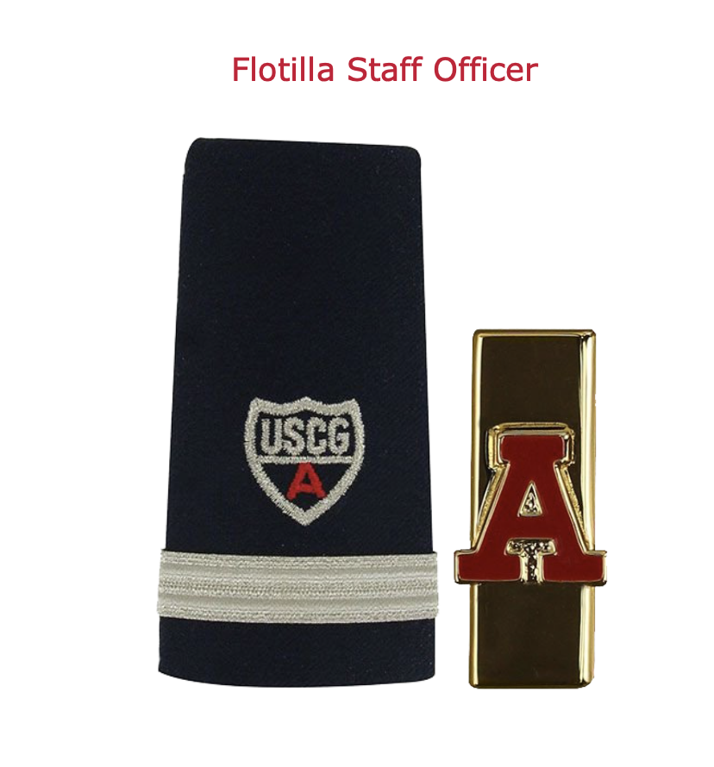
Flotilla Staff Officer (FSO).
Flotilla Staff Officers (FSOs) in any mission area (e.g., FSO-MT, FSO-HR, FSO-PA, etc.)
Due by the 5th of each month.
Where do the reports go:
Flotilla Vice Commander (VFC) – to keep flotilla leadership informed.
Division Staff Officer (SO) for your mission area – to contribute to division-level reporting and coordination.
Helps both flotilla and division leadership understand:
What’s been accomplished.
What challenges exist.
Where additional support or coordination may be needed.
Ensures your efforts and needs are recognized and acted on as part of the broader mission success.

Slide 10

Division Staff Officer (SO).
Division Staff Officers (SO) in any mission area (e.g., SO-MT, SO-HR, SO-PA, etc.)
Due by the 8th of each month.
Submit to Division Vice Commander (VDCR) – to keep division leadership informed.
Assistant District Staff Office (ADSO) for your mission area – to contribute to district-level reporting and coordination.
Helps both division and district leadership understand:
What’s been accomplished.
What challenges exist.
Where additional support or coordination may be needed.
Ensures your efforts and needs are recognized and acted on as part of the broader mission success.

Slide 11

Assistant District Staff officer (ADSO).
Assistant District Staff Officers (ADSOs) in each mission area (e.g., ADSO-MT, ADSO-HR, ADSO-PA, etc.)
Due by the 12th of each month.
Your report goes to the District Staff Officer (DSO) for your mission area.
Provides the DSO with updates on:
Division-level mission activities and progress.
Areas where support or guidance may be needed.
Trends that may require district-wide action or training.
Supports effective district program management and alignment with national goals.

Slide 12
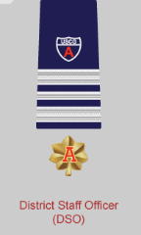
District Staff Officer (DSO).
District Staff Officers (DSOs) in each mission area (e.g., DSO-MT, DSO-HR, DSO-PA, etc.)
Due by the 15th of each month.
Your report goes to the District Directorate Chief (DDC) for your area of responsibility.
Offers a district-wide overview of your mission area.
Enables the DDC to:
Monitor performance across all units.
Identify trends, successes, and problem areas.
Advocate for support or resources if needed.
Builds the foundation for district leadership to report effectively to national programs.

Slide 13
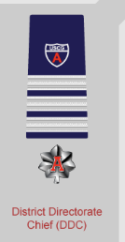
District Directorate Chief (DDC).
District Directorate Chiefs (DDCs) for each functional area (e.g., Response, Prevention, Logistics, etc.)
Your report is due by the 18th of each month.
Your report goes to the District Chief of Staff (DCOS).
Consolidates mission area data from all District Staff Officers (DSOs).
Enables the DCOS to:
Prepare a comprehensive operational overview of the entire district.
Spot issues or patterns across multiple mission areas.
Coordinate high-level responses and resource allocation.
Essential for preparing leadership briefings and forwarding information up to the Commodore and National leadership.

Slide 14

What goes in the reports?
Your report will contain the highs and lows for the reporting period.
You can also let them know what your plans are going forward.
If nothing happened, just a simple
“ No Report” will do.

Slide 15

Also:
Your report should also contain any information that you wish passed up the Chain of Leadership and Management (COLM).
The more information that is passed along, at all levels, the better recognition and problem solving can be.

Slide 16
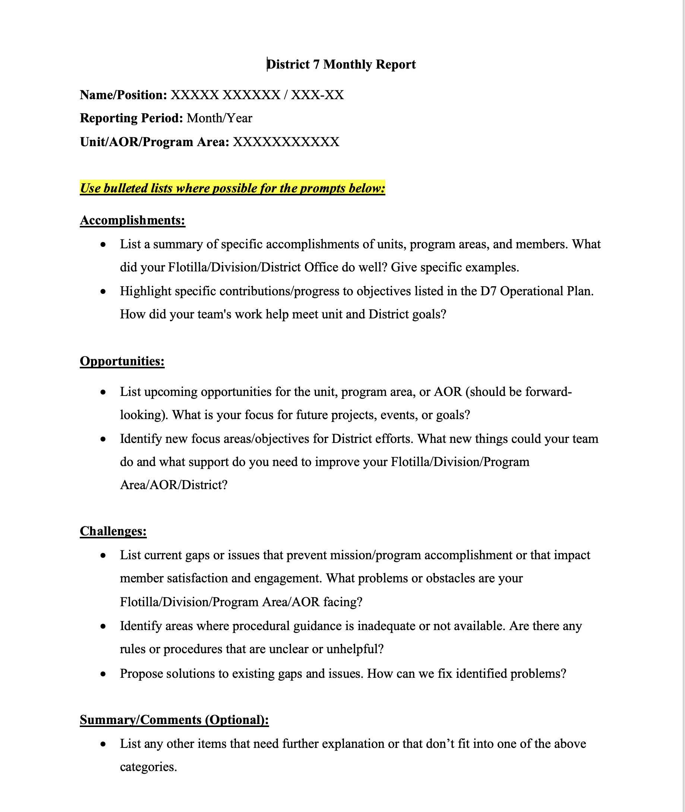

Sample report formats: Monthly.

Slide 17
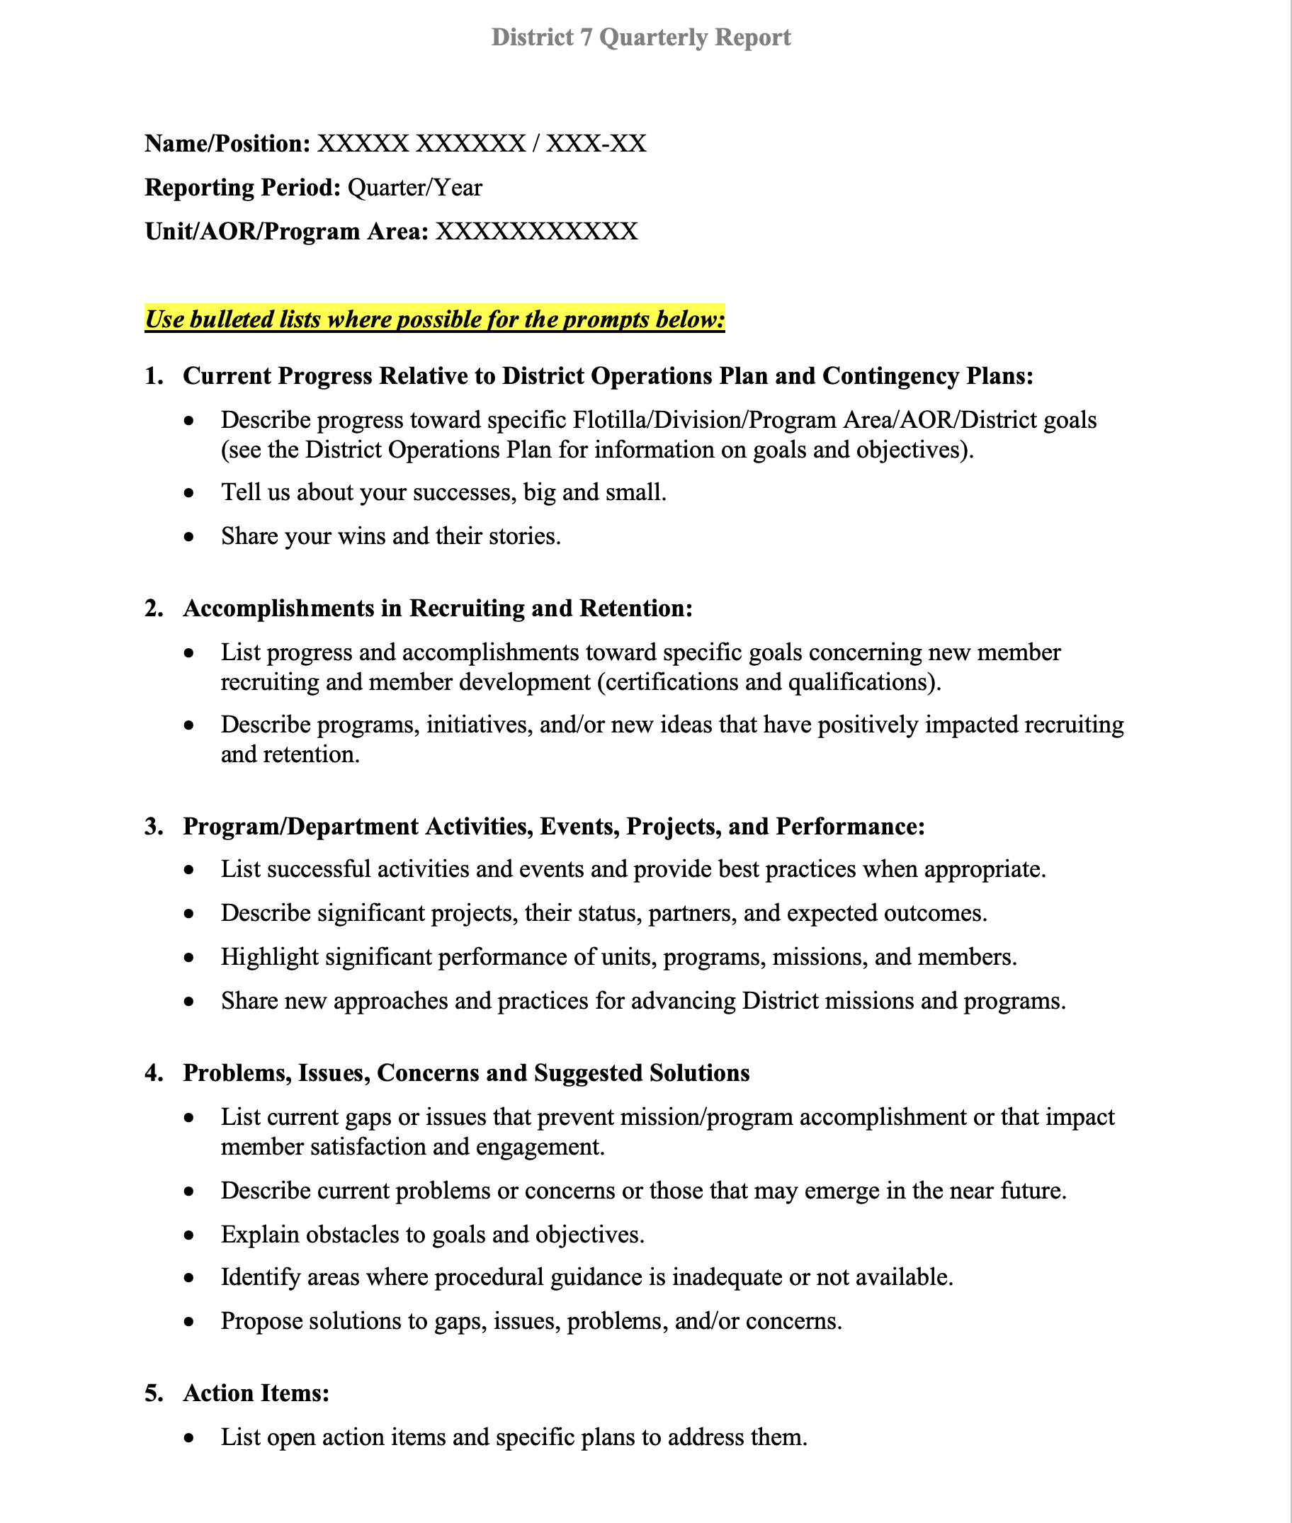
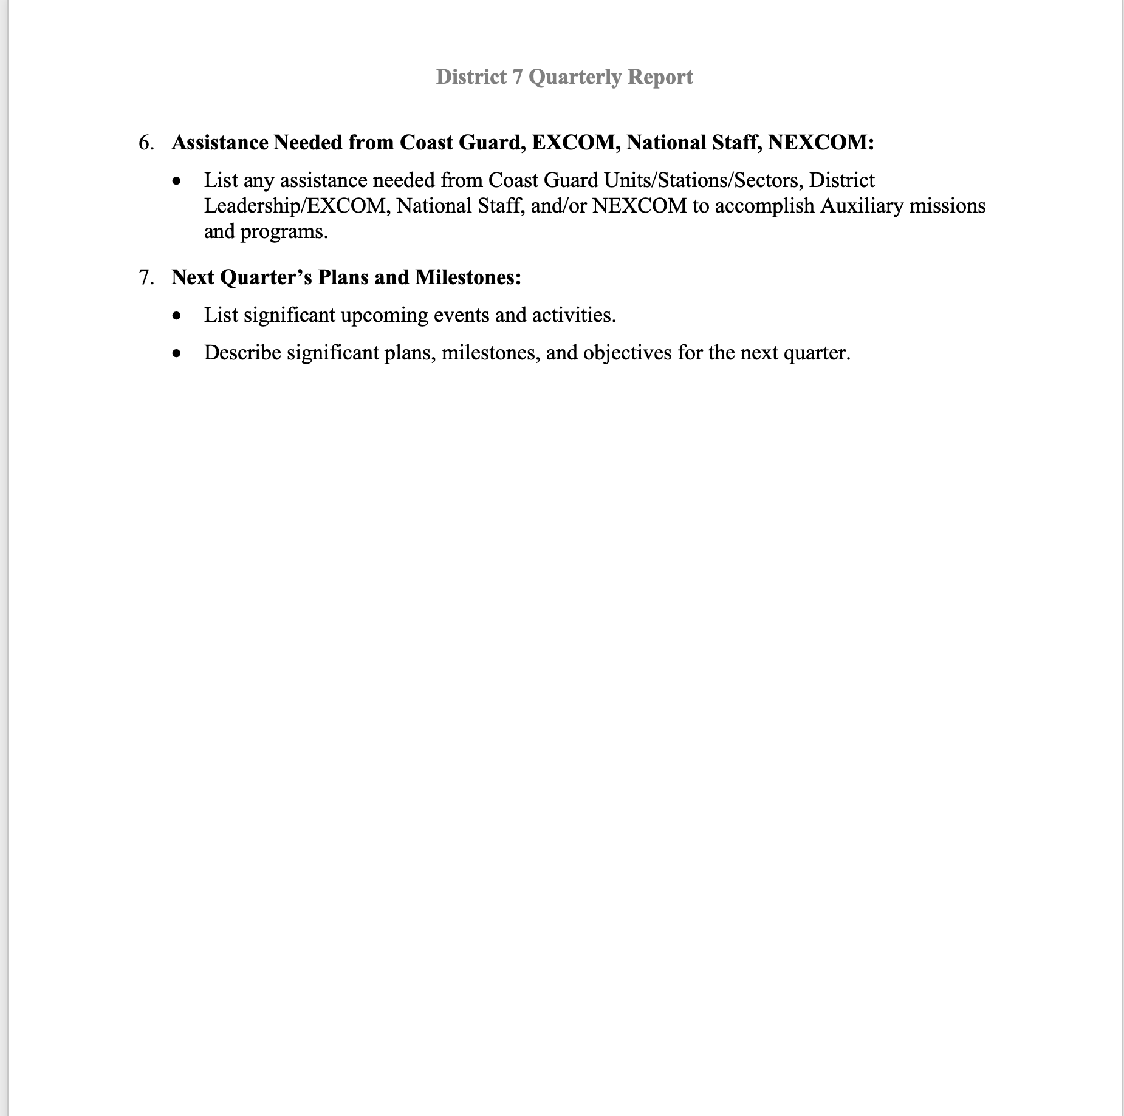
Sample report formats: Quarterly.

Slide 18
Summary.
By now you know who gets your report.
What reports to submit.
When they are due, and the importance of the timeline.
Where you send your report.
Hopefully, you now understand the why.

Slide 19

Thank you from your District member training team.
Please refer to policy letter 002/25A from Commodore Goodwin dated 15 April 2025 for more information.
Contact your COLM for more guidance.

