Slide 1
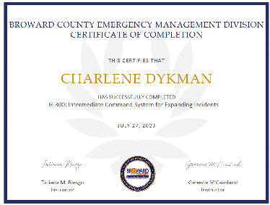
How do I take ICS-300 and ICS-400? ISC-300 and ICS-400 are advanced courses. They are in-person classes.
Seventh District Member Training

Slide 2
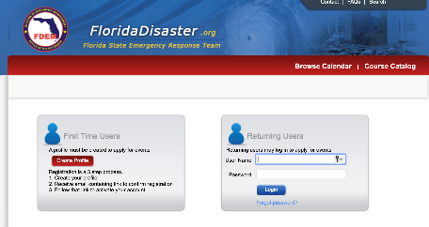
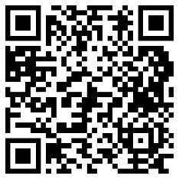
Many have requested a source for ICS-300 and Ics-400.
In Florida it’s G-300.
First go here:
https://trac.floridadisaster.org/trac/loginform.aspx

Slide 3
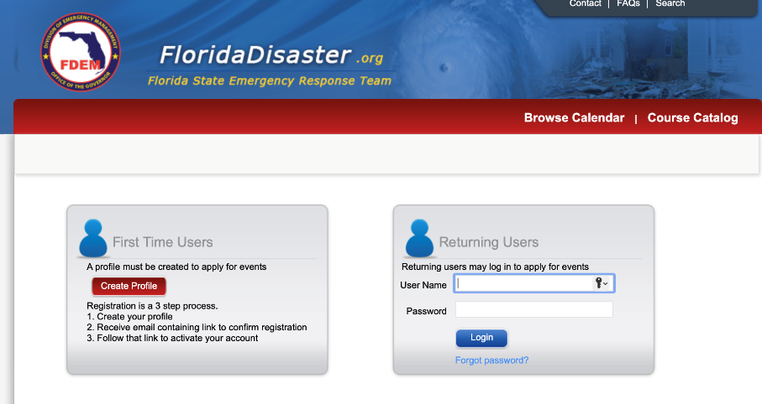
Create an account profile, then login.

Slide 4

Prerequisites.
ICS-100
ICS-200
ICS-700
ICS-800

Slide 5
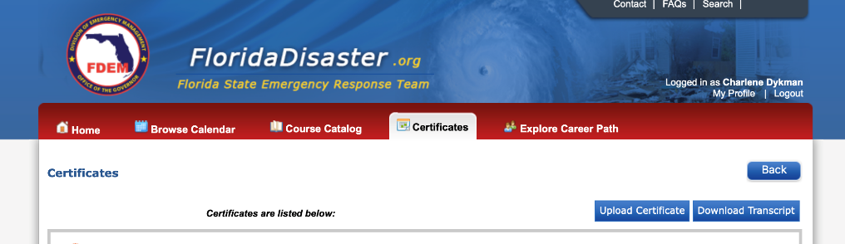
You will need to upload your ICS-100, 200, 700 and 800 certificates.

Slide 6
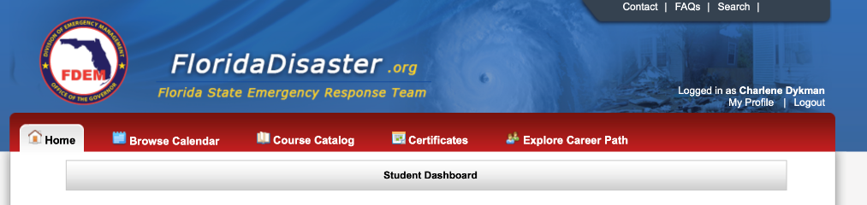
Look for G-300
Intermediate Incident Command System for expanding incidents.
Find one in your area.

Slide 7
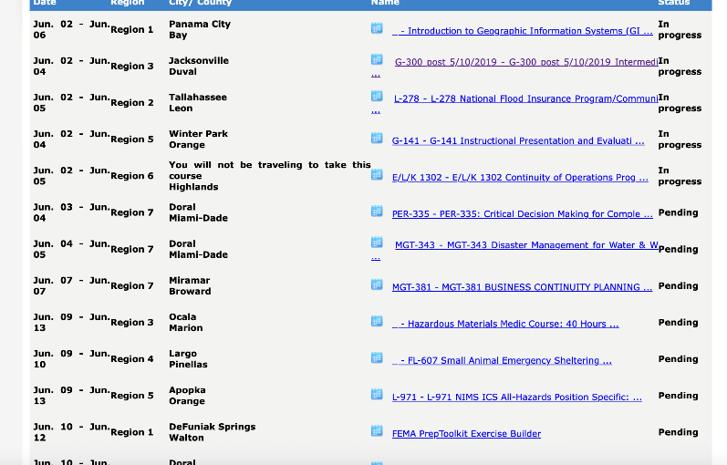
Click on the course in your area.
The course has to be “Pending”
to apply for it.

Slide 8
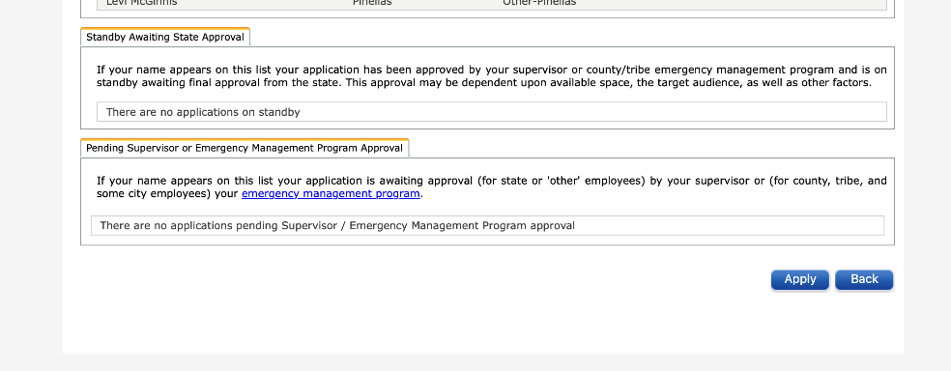
Scroll to the bottom of the page.
Click on Apply and follow the prompts.

Slide 9

Once you get your G-300/G-400 certificate.
You will need to upload this to your record.
Contact your FSO-IS for assistance.

Slide 10

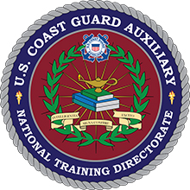
Your HR team and your MT team look forward to helping you.

